Slide 1


Distributed Weather Data Processing and Trend Analysis REVIEW – 1&2
Team Members
Roll No Name
2320030207 A. Subash
2320030208 C. Saisandeep
2320030164 G. Rohith Sai
Department of Computer Science and Engineering
KONERU LAKSHMAIAH EDUCATION FOUNDATION

Slide 2
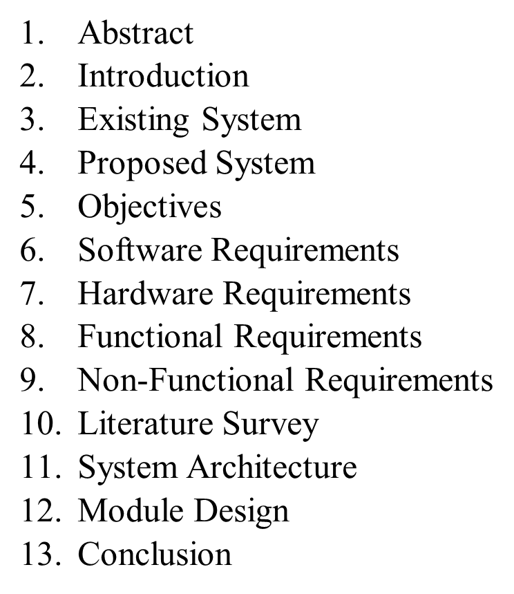
OUTLINE

Slide 3
Introduction
Weather data is highly dynamic and generated continuously from multiple global locations
With the increase in real-time weather monitoring, traditional systems cannot process large-scale streaming data efficiently
Big Data technologies enable scalable processing of massive weather data
This project integrates Apache Kafka, Apache Spark, and HDFS to build a real-time analytics pipeline capable of:
Collecting live weather data from global city nodes
Streaming and processing real-time data
Detecting anomalies and analyzing weather trends
Storing large-scale data in distributed systems
Visualizing weather insights using interactive dashboards

Slide 4
Abstract
Weather systems generate massive amounts of real-time environmental data every second. Traditional data processing systems struggle to efficiently analyze this continuous stream of information.
This project proposes a Big Data based Weather Data Processing and Trend Analysis System that uses Apache Kafka for real-time data streaming, Apache Spark for distributed data processing, and Hadoop HDFS for scalable data storage.
The system collects weather data from APIs such as OpenWeatherMap, processes the data using Spark Streaming, and performs analytics to detect anomalies and identify weather trends.
The system provides insights including:
Temperature trends
Humidity variations
Weather pattern changes
Anomaly detection (extreme conditions)
Interactive dashboards visualize the analytics results using tools like React and Recharts, helping users understand weather conditions and make informed decisions.

Slide 5
Existing System
Traditional weather monitoring systems rely on:
Static historical datasets
Batch processing methods
Manual analysis
Limitations of existing systems:
Lack of real-time data processing
Limited scalability
Slow response time
Inefficient handling of large datasets
Limited capability to detect anomalies and trends
These limitations reduce the effectiveness of real-time weather monitoring and analysis

Slide 6
Proposed Method
The proposed system uses Big Data technologies to analyze weather data in real-time
Key technologies used:
Apache Kafka – Real-time data streaming
Apache Spark – Distributed data processing
Hadoop HDFS – Large-scale data storage
Analytics Models – Anomaly detection and trend analysis
Visualization Tools – Dashboard analytics (React + Recharts)
The system processes real-time weather data, performs analysis, detects anomalies, computes trends, and displays insights through interactive dashboards

Slide 7
Objectives
The main objectives of the project are:
Collect real-time weather data from APIs (e.g., OpenWeatherMap)
Stream data using Apache Kafka
Perform large-scale data processing using Apache Spark
Store historical weather data in Hadoop HDFS
Generate insights such as temperature trends and humidity variations
Detect anomalies in weather conditions
Visualize weather data using interactive dashboards
Provide real-time weather insights for better analysis and decision-making

Slide 8
SOFTWARE REQUIREMENTS
Programming Languages:
Python
PySpark
Big Data Tools:
Apache Kafka
Apache Spark
Hadoop HDFS
Libraries:
Pandas
NumPy
Frontend / Visualization:
React.js
Recharts
API Integration:
OpenWeatherMap API

Slide 9
HARDWARE REQUIREMENTS
Minimum System Requirements:
Processor:
Intel i5 or above
RAM:
Minimum 8 GB
16 GB recommended for Big Data processing
Storage:
Minimum 500 GB
Operating System:
Windows
Linux (Preferred for Hadoop & Spark)
Network:
Stable internet connection for real-time weather data collection (API access)

Slide 10
FUNCTIONAL REQUIREMENTS
The system must perform the following functions:
Collect real-time weather data from APIs (e.g., OpenWeatherMap)
Stream data using Apache Kafka
Process streaming data using Apache Spark
Store processed data in Hadoop HDFS
Clean and preprocess weather data
Generate analytics insights (temperature, humidity, trends)
Detect anomalies in weather conditions
Display results through interactive dashboards

Slide 11
NON-FUNCTIONAL REQUIREMENTS
Scalability:
The system must handle large volumes of real-time weather data from multiple locations
Performance:
The system should efficiently process streaming weather data with low latency
Reliability:
Data processing pipelines must ensure accurate and consistent results
Availability:
The system should run continuously to support real-time weather monitoring
Security:
Secure API access and data protection mechanisms should be implemented

Slide 12
Literature Survey
Paper Title | Reference Link | Drawback | Future Work
Real-Time Weather Monitoring Using Distributed Systems | https://arxiv.org/abs/1709.03546 | High latency due to centralized data collection and lack of real-time stream processing. | Can be extended using distributed streaming frameworks like Kafka for low-latency ingestion.
Apache Spark for Large-Scale Weather Data Processing | https://arxiv.org/abs/1802.00316 | Requires high memory resources and complex cluster configuration for weather datasets. | Optimization using cloud-based deployment and auto-scaling Spark clusters.
Big Data Analytics for Climate and Weather Patterns | https://ieeexplore.ieee.org/document/7488251 | Limited to historical data analysis and lacks real-time anomaly detection capabilities. | Integration with live weather streams for dynamic trend and anomaly analysis.
Distributed Sensor Data Processing Using Hadoop | https://www.sciencedirect.com/science/article/pii/S1877050917322094 | Scalability issues when handling high-velocity data from multiple sensor nodes simultaneously. | Adoption of distributed streaming platforms for continuous weather data ingestion.
Weather Anomaly Detection Using Machine Learning | https://link.springer.com/article/10.1007/s00521-020-04762-8 | Complex model design and high computational cost for real-time anomaly classification. | Simplified architectures with intelligent real-time anomaly detection and severity classification.

Slide 13
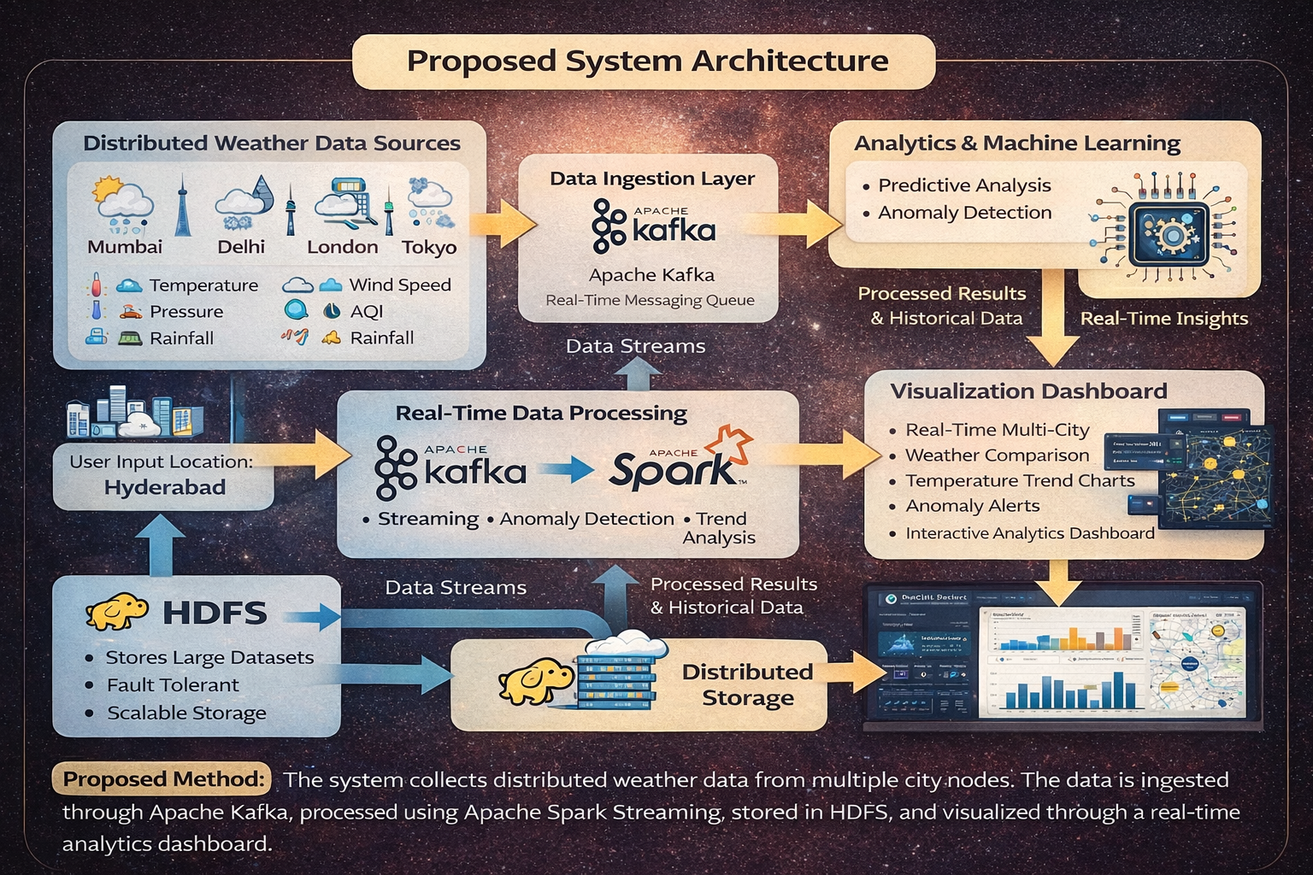
Architecture

Slide 14
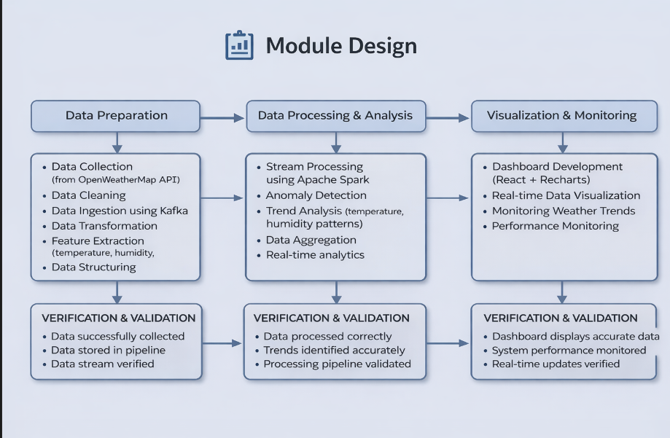
Module Design

Slide 15
Conclusion
This project demonstrates how Big Data technologies can be used to process and analyze large volumes of weather data in real time.
The system collects weather data from multiple sources, processes it using distributed technologies, and displays insights through an interactive dashboard.
Using tools like Apache Kafka, Apache Spark, and HDFS, the system can efficiently handle streaming data, detect anomalies, and visualize weather trends.
This project shows how Big Data platforms can help in real-time environmental monitoring and data-driven decision making.

Slide 16
References
Research Papers
Zaharia, M., et al. “Apache Spark: A Unified Engine for Big Data Processing.” IEEE.
Kreps, J., Narkhede, N., Rao, J. “Kafka: A Distributed Messaging System for Log Processing.” LinkedIn Engineering.
Carbone, P., Katsifodimos, A. “Apache Flink and Spark Streaming for Real-Time Data Processing.” IEEE.
Apache Spark Official Documentation – https://spark.apache.org
Apache Kafka Documentation – https://kafka.apache.org
OpenWeatherMap API Documentation – https://openweathermap.org/api

Slide 17
THANK YOU

